Slide 1
A Data Science Approach to Maintaining Water Sources of Tanzania
Pump Up the Data
Jeffrey Oller

Slide 2
Water Pump Maintenance Procedures
Create predictive model
Use predictive model on existing and new pumps
Recollect data periodically and update model
Record Data on Pumps
Predict Pumps’ Conditions
Maintain Pumps
Fit Model
Predict pump’s condition
Find/build new pump
Record new data

Slide 3
Leveraging Predictive Model to Build More Effective Pumps
Determine feature importances
Filter out variables outside our control
Determine positive/negative correlations of feature importances

Slide 4
Data Source:
Target Variable:
Taarifa and the Tanzanian Ministry of Water
https://www.drivendata.org/competitions/7/pump-it-up-data-mining-the-water-table/
Does water source need maintenance?
Ternary problem -> binary problem

Slide 5
Feature Engineering
elevation | missing_elevation
1390 | 0
686 | 0
0 | 1
1062 | 0
0 | 1
0 | 1
One-hot encoding
Boolean variables for NaN
Collapse trinary classification to binary classification problem

Slide 6
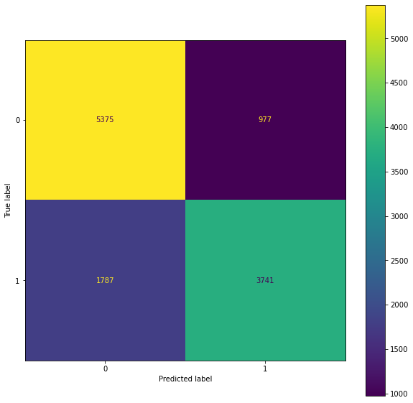
Logistic Regression Classifier (Baseline)
Test Acccuracy: | 76.73%
Precision: | 77%
Recall: | 77%
F1-Score: | 77%

Slide 7
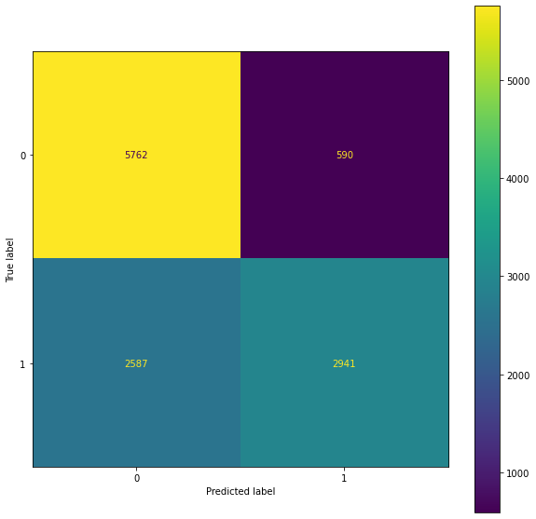
Random Forest Classifier
Test Acccuracy: | 73.07%
Precision: | 75%
Recall: | 73%
F1-Score: | 72%

Slide 8

Random Forest Classifier with Random Search
Test Acccuracy: | 75.28%
Precision: | 77%
Recall: | 77%
F1-Score: | 77%

Slide 9
Gradient Boosting Classifier
Test Acccuracy: | 79.17%
Precision: | 80%
Recall: | 79%
F1-Score: | 79%

Slide 10
Future Improvements:
Either abandon or use pipelines more effectively to permit feature labels
Higher level interactions for elevation, latitude and longitude

Slide 11
See me for Oktoberfest RSVP for 14th (next Friday)
Jeffrey Oller

